Slide 1
DEBRE BIRHAN UNIVERSITY Department of data science and Statistics
Stat3071 lecture note
Chapter Three
3. Common Multivariate Distribution

Slide 2
con’t…
3.1 Multidimensional Random Variables
Multidimensional Random Variables (also called Random Vectors) extend the concept of a single random variable to multiple dimensions.
They are used to model scenarios where multiple random quantities are observed simultaneously, and their relationships (dependencies) are of interest.
An n-dimensional random vector X = (X₁, X₂, … , X_{n}) is an ordered set of n random variables, each of which describes some aspects of a statistical outcome.

Slide 3
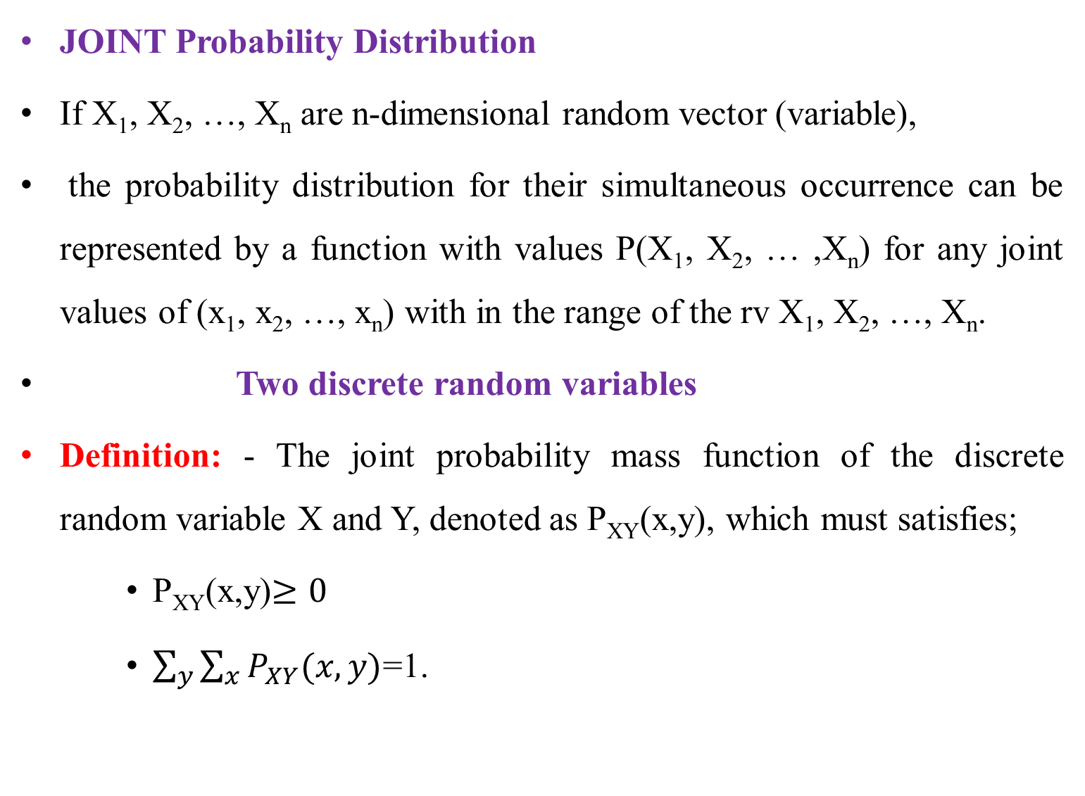
Con’t…
JOINT Probability Distribution
If X₁, X₂, …, X_{n} are n-dimensional random vector (variable),
the probability distribution for their simultaneous occurrence can be represented by a function with values P(X₁, X₂, … ,X_{n}) for any joint values of (x₁, x₂, …, x_{n}) with in the range of the rv X₁, X₂, …, X_{n}.
Two discrete random variables
Definition: - The joint probability mass function of the discrete random variable X and Y, denoted as P_{XY}(x,y), which must satisfies;
P_{XY}(x,y)$≥0$
$\sum_{y}{\sum_{x}{P_{XY}(x,y)}}$=1.

Slide 4
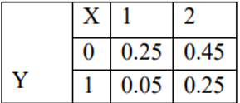
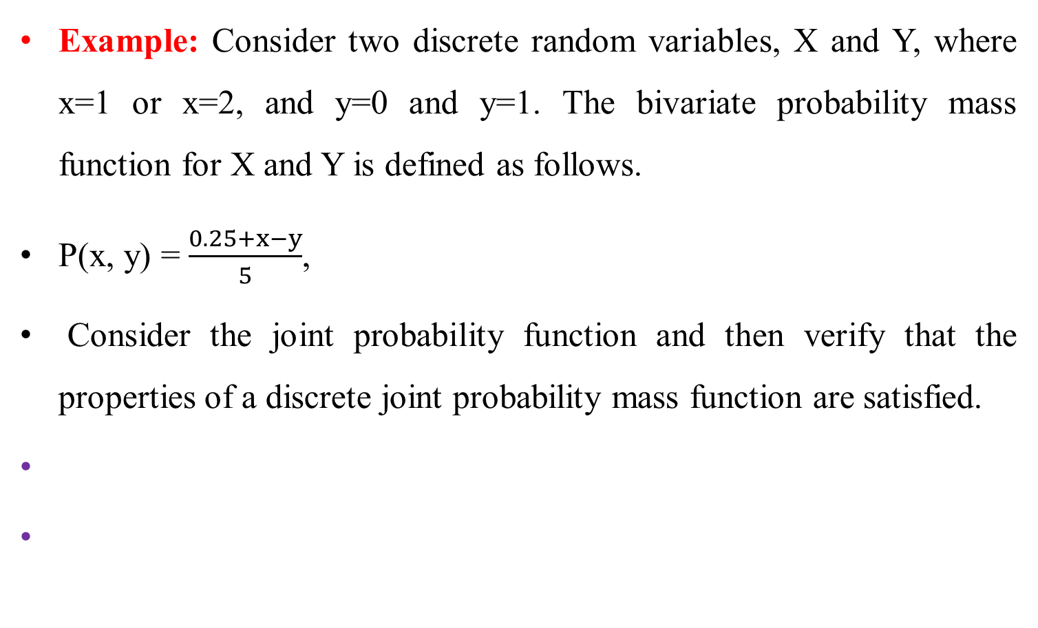
con’t…
Example: Consider two discrete random variables, X and Y, where x=1 or x=2, and y=0 and y=1. The bivariate probability mass function for X and Y is defined as follows.
P(x, y) = $\frac{0.25+x−y}{5}$,
Consider the joint probability function and then verify that the properties of a discrete joint probability mass function are satisfied.

Slide 5
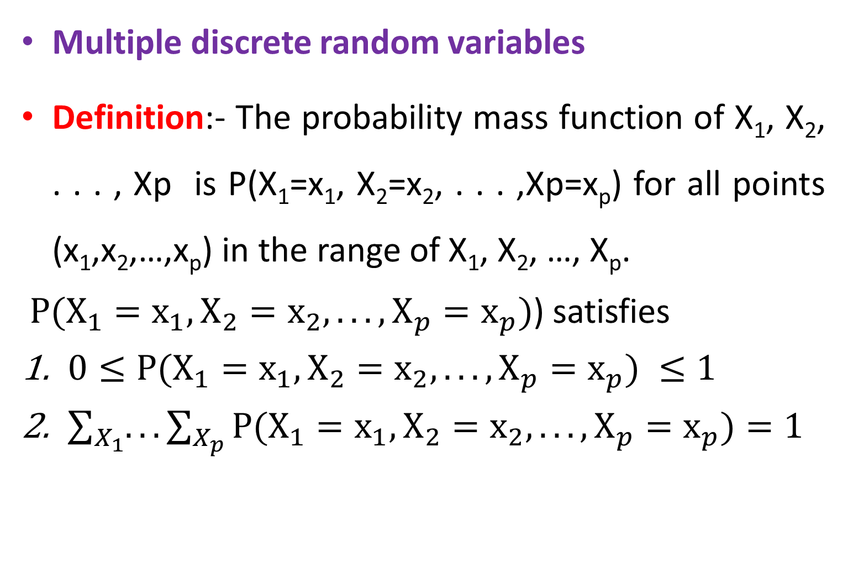
Con’t…
Multiple discrete random variables
Definition:- The probability mass function of X₁, X₂, . . . , Xp is P(X₁=x₁, X₂=x₂, . . . ,Xp=x_{p}) for all points (x₁,x₂,…,x_{p}) in the range of X₁, X₂, …, X_{p}.
$P(X_{1}=x_{1}, X_{2}=x_{2}, . . . ,X_{p}=x_{p})$) satisfies
$0≤P(X_{1}=x_{1}, X_{2}=x_{2}, . . . ,X_{p}=x_{p}) ≤1$
$\sum_{X_{1}}{.}..\sum_{X_{p}}{P(X_{1}=x_{1}, X_{2}=x_{2}, . . . ,X_{p}=x_{p})=1}$

Slide 6
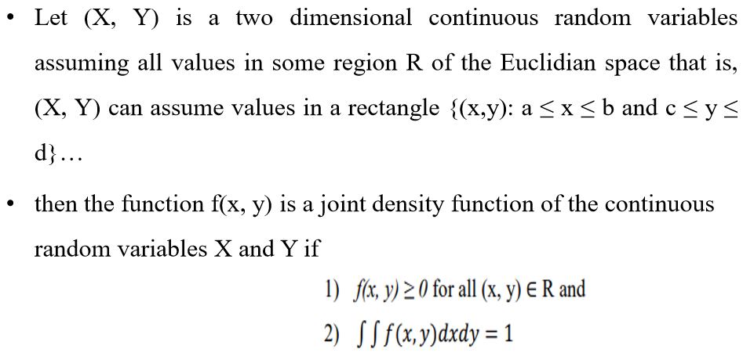
Joint Continuous random variable

Slide 7
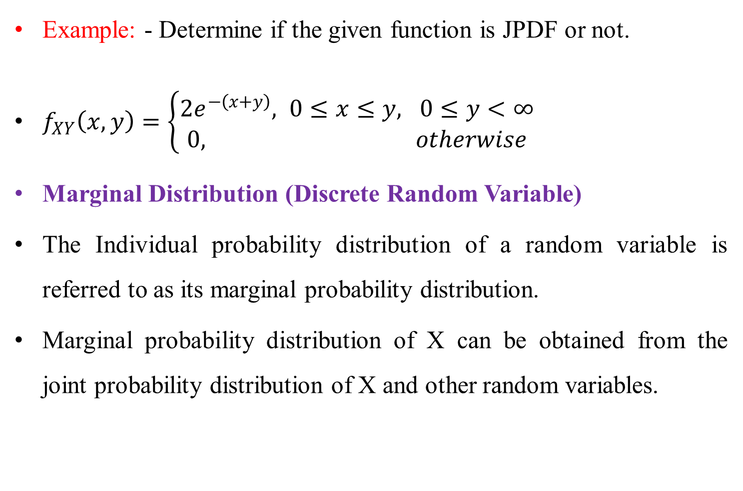
Con’t…
Example: - Determine if the given function is JPDF or not.
$f_{XY}\left(x,y\right)=\left\{\begin{aligned}2e^{−\left(x+y\right)}, 0≤x≤y, 0≤y<∞ \\ 0, otherwise\end{aligned}\right.$
Marginal Distribution (Discrete Random Variable)
The Individual probability distribution of a random variable is referred to as its marginal probability distribution.
Marginal probability distribution of X can be obtained from the joint probability distribution of X and other random variables.

Slide 8
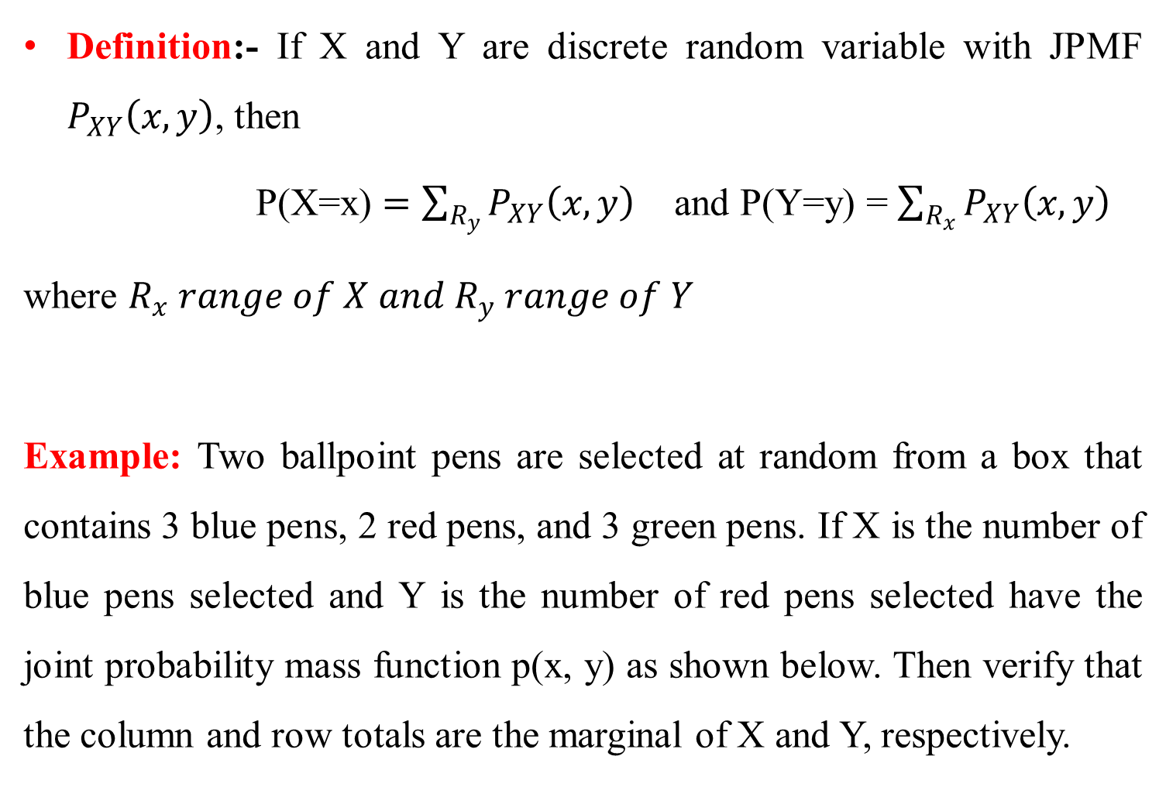
Con’t…
Definition:- If X and Y are discrete random variable with JPMF $P_{XY}\left(x,y\right)$, then
P(X=x) $=\sum_{R_{y}}{P_{XY}\left(x,y\right)}$ and P(Y=y) = $\sum_{R_{x}}{P_{XY}\left(x,y\right)}$
where $R_{x} range of X and R_{y} range of Y$
Example: Two ballpoint pens are selected at random from a box that contains 3 blue pens, 2 red pens, and 3 green pens. If X is the number of blue pens selected and Y is the number of red pens selected have the joint probability mass function p(x, y) as shown below. Then verify that the column and row totals are the marginal of X and Y, respectively.

Slide 9
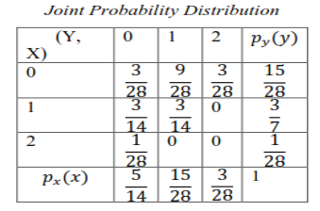
Con’t..

Slide 10
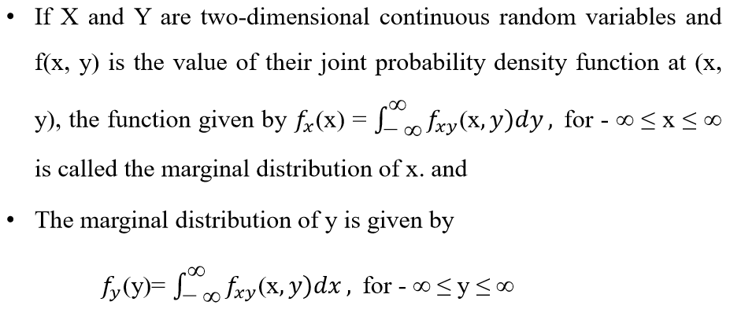
Marginal Distribution (continuous Random Variable)

Slide 11
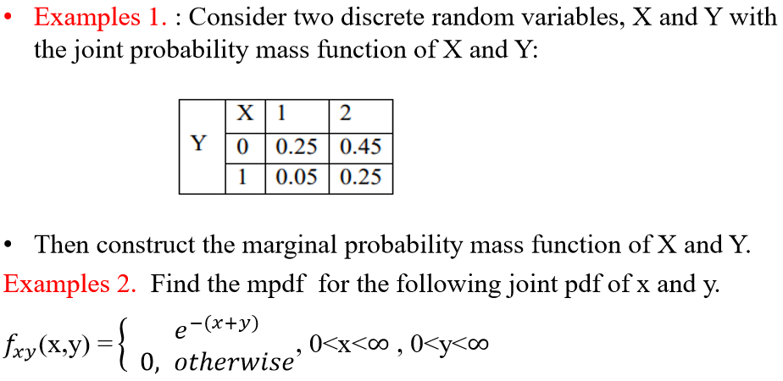
Cont’t…

Slide 12
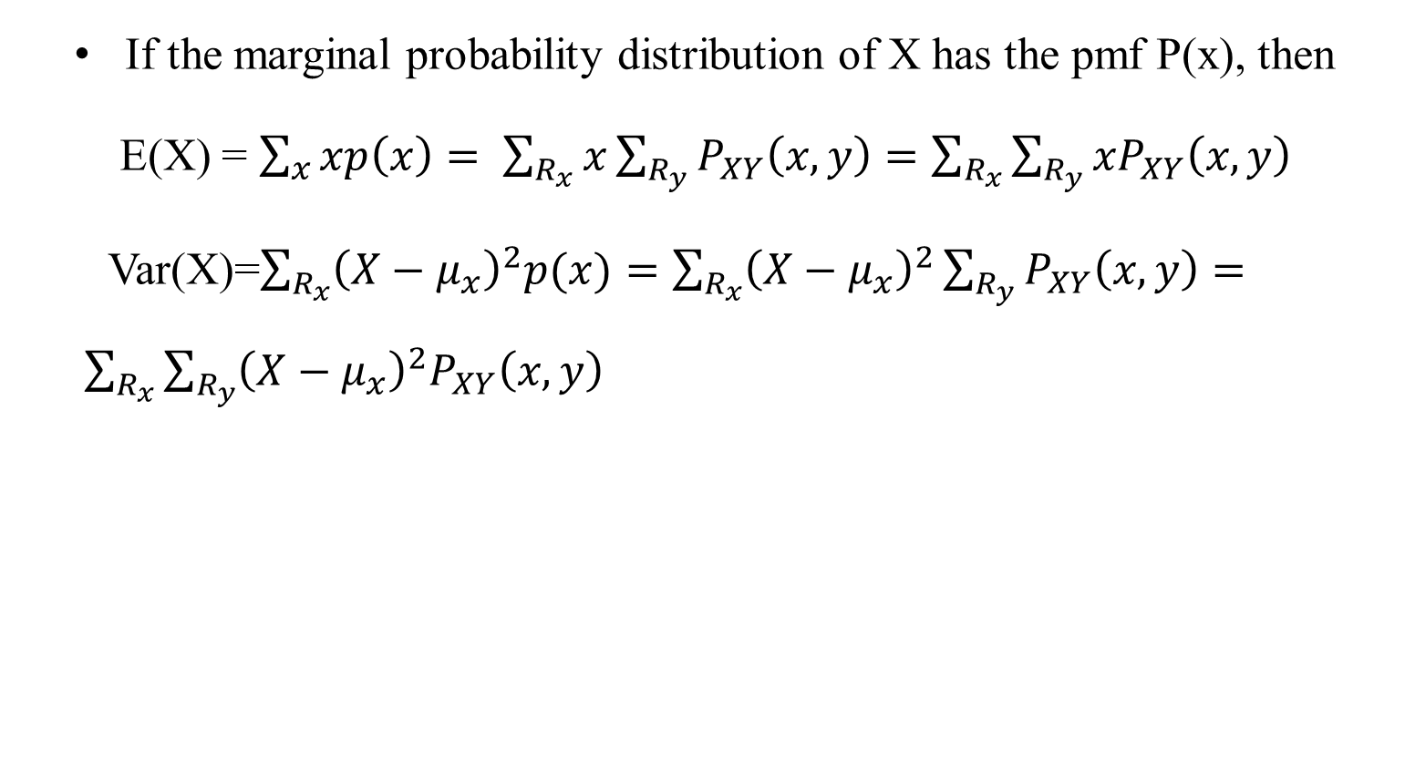
Mean and variance from joint probability distribution
If the marginal probability distribution of X has the pmf P(x), then
E(X) = $\sum_{x}{xp\left(x\right)= \sum_{R_{x}}{x}}\sum_{R_{y}}{P_{XY}\left(x,y\right)}=\sum_{R_{x}}{\sum_{R_{y}}{{xP}_{XY}\left(x,y\right)}}$
Var(X)=$\sum_{R_{x}}{{\left(X−μ_{x}\right)}^{2}p(x)}=\sum_{R_{x}}{{\left(X−μ_{x}\right)}^{2}\sum_{R_{y}}{P_{XY}\left(x,y\right)}}= \sum_{R_{x}}{\sum_{R_{y}}{{{\left(X−μ_{x}\right)}^{2}P}_{XY}\left(x,y\right)}}$

Slide 13
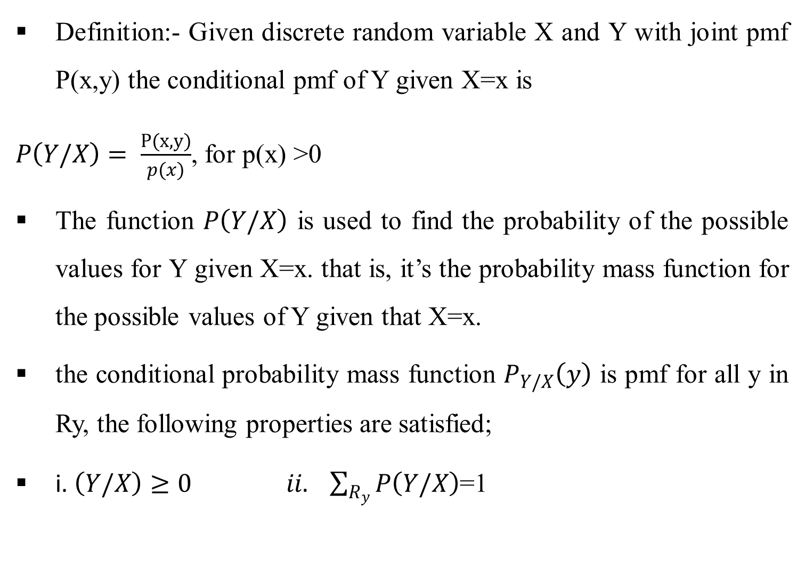
Conditional probability distribution
Definition:- Given discrete random variable X and Y with joint pmf P(x,y) the conditional pmf of Y given X=x is
$P\left(Y/X\right)= \frac{P(x,y)}{p(x)}$, for p(x) >0
The function $P\left(Y/X\right)$ is used to find the probability of the possible values for Y given X=x. that is, it’s the probability mass function for the possible values of Y given that X=x.
the conditional probability mass function $P_{Y/X}\left(y\right)$ is pmf for all y in Ry, the following properties are satisfied;
i. $\left(Y/X\right)≥0 ii. \sum_{R_{y}}{P\left(Y/X\right)}$=1

Slide 14
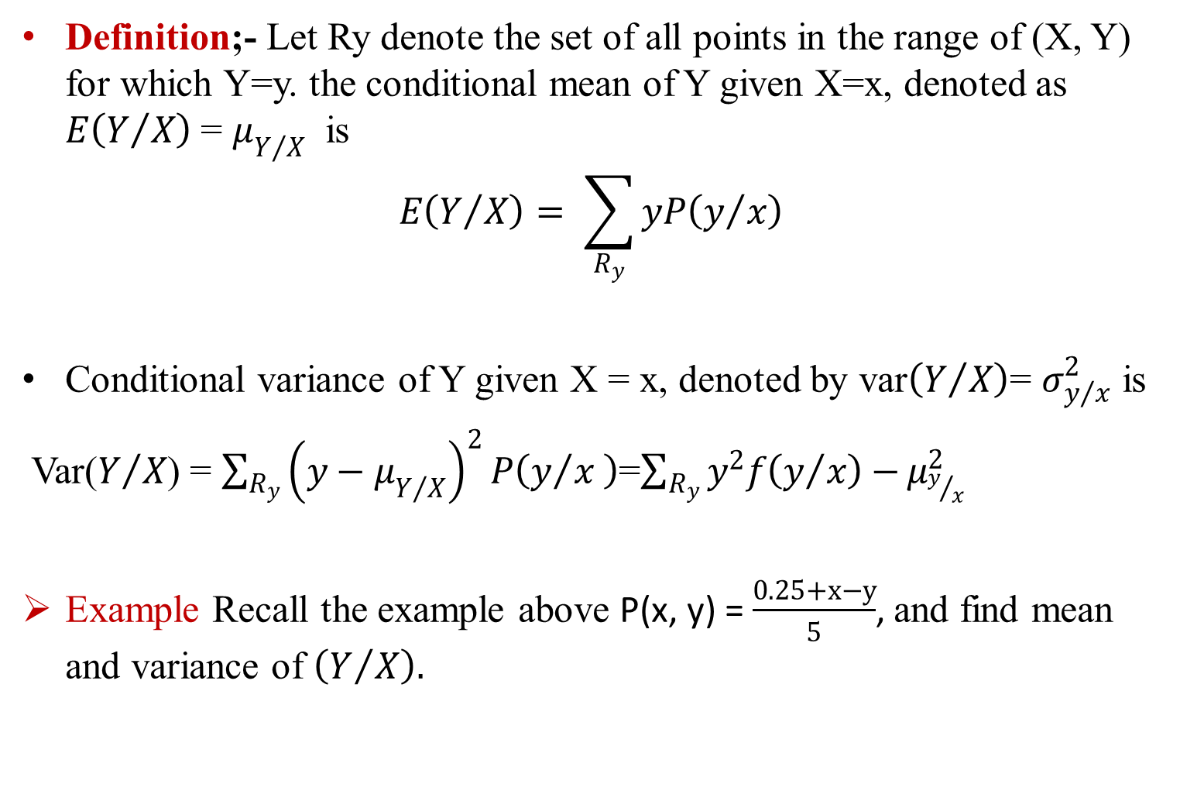
Con’t…
Definition;- Let Ry denote the set of all points in the range of (X, Y) for which Y=y. the conditional mean of Y given X=x, denoted as $E\left(Y/X\right)$ = $μ_{Y/X}$ is
$$E\left(Y/X\right)= \sum_{R_{y}}{yP\left(y/x\right)}$$
Conditional variance of Y given X = x, denoted by var$\left(Y/X\right)$= $σ_{y/x}^{2}$ is
Var($Y/X$) = $\sum_{R_{y}}{{\left(y−μ_{Y/X}\right)}^{2}P\left(y/x \right)}$=$\sum_{R_{y}}{y^{2}f\left(y/x\right)−}μ_{y/x}^{2}$
Example Recall the example above P(x, y) = $\frac{0.25+x−y}{5}$, and find mean and variance of $\left(Y/X\right).$

Slide 15
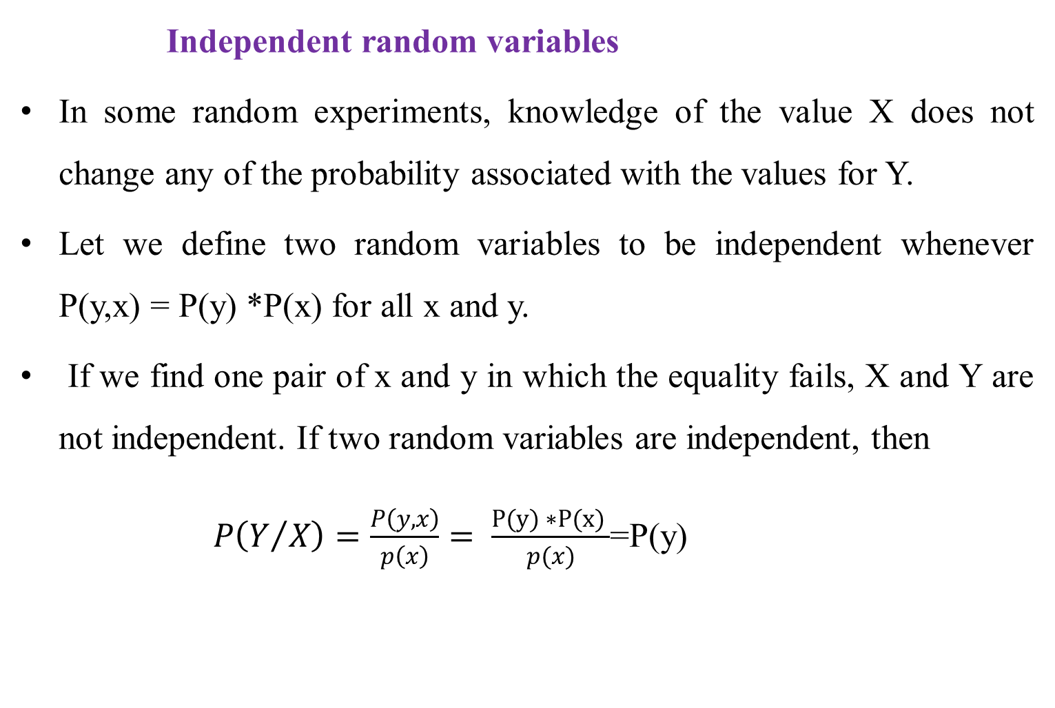
Con’t…
Independent random variables
In some random experiments, knowledge of the value X does not change any of the probability associated with the values for Y.
Let we define two random variables to be independent whenever P(y,x) = P(y) *P(x) for all x and y.
If we find one pair of x and y in which the equality fails, X and Y are not independent. If two random variables are independent, then
$P\left(Y/X\right)=\frac{P\left(y,x\right)}{p\left(x\right)}= \frac{P(y) ∗P(x) }{p(x)}$=P(y)

Slide 16
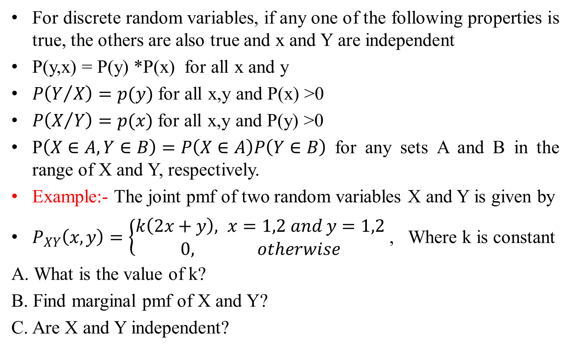
Con’t…
For discrete random variables, if any one of the following properties is true, the others are also true and x and Y are independent
P(y,x) = P(y) *P(x) for all x and y
$P\left(Y/X\right)=p(y)$ for all x,y and P(x) >0
$P\left(X/Y\right)=p(x)$ for all x,y and P(y) >0
P$\left(X∈A, Y∈B\right)=P\left(X∈A\right)P\left(Y∈B\right)$ for any sets A and B in the range of X and Y, respectively.
Example:- The joint pmf of two random variables X and Y is given by
$P_{XY}\left(x,y\right)=\left\{\begin{aligned}k\left(2x+y\right), x=1,2 and y=1,2 \\ 0, otherwise\end{aligned}\right.$ , Where k is constant
A. What is the value of k?
B. Find marginal pmf of X and Y?
C. Are X and Y independent?

Slide 17
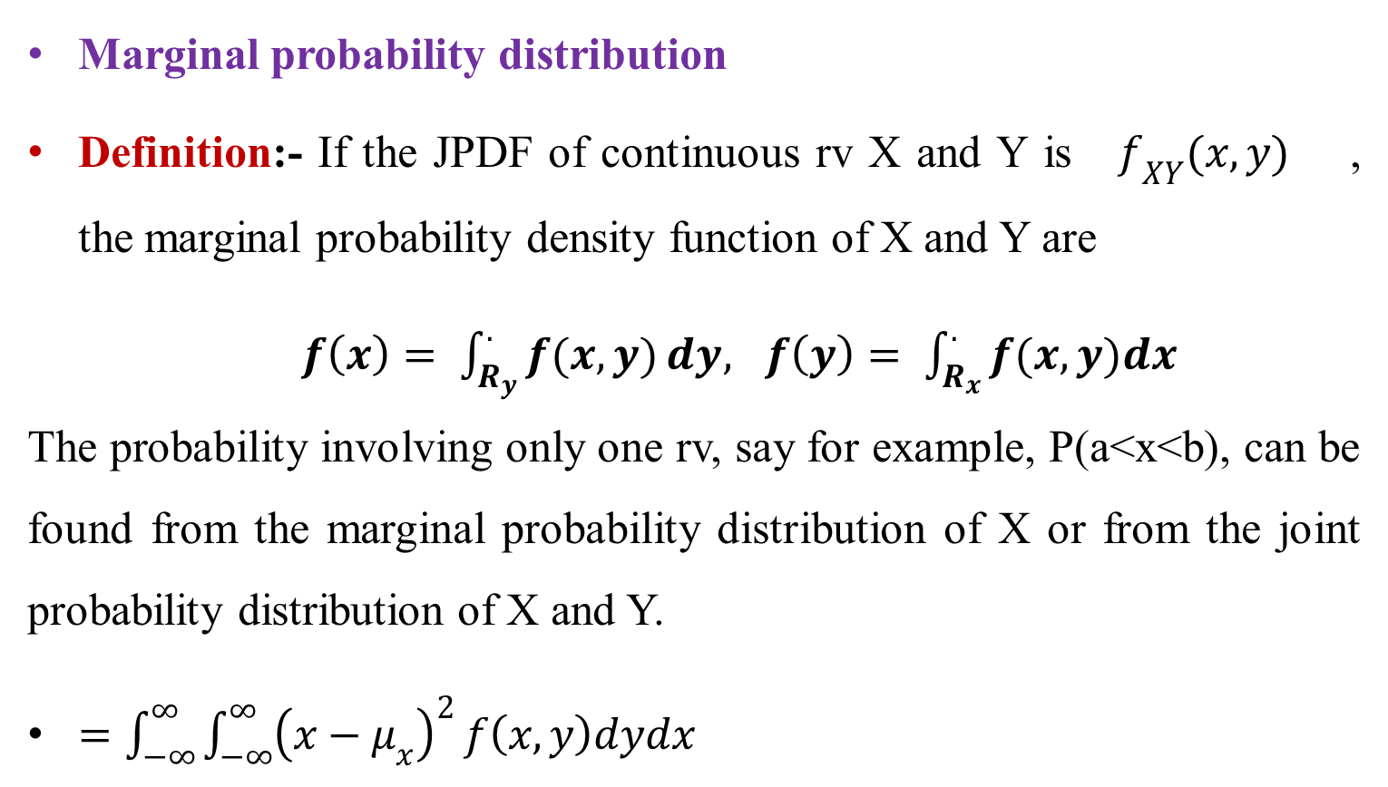
Marginal and conditional distribution of continuous random variables
Marginal probability distribution
Definition:- If the JPDF of continuous rv X and Y is $f_{XY}(x,y)$ , the marginal probability density function of X and Y are
$f\left(x\right)= \int_{R_{y}}^{.}{f(x,y)}dy, f\left(y\right)= \int_{R_{x}}^{.}{f(x,y)dx}$ The probability involving only one rv, say for example, P(a<x<b), can be found from the marginal probability distribution of X or from the joint probability distribution of X and Y.
$=\int_{−∞}^{∞}{\int_{−∞}^{∞}{{\left(x−μ_{x}\right)}^{2}}f\left(x,y\right)dydx}$

Slide 18
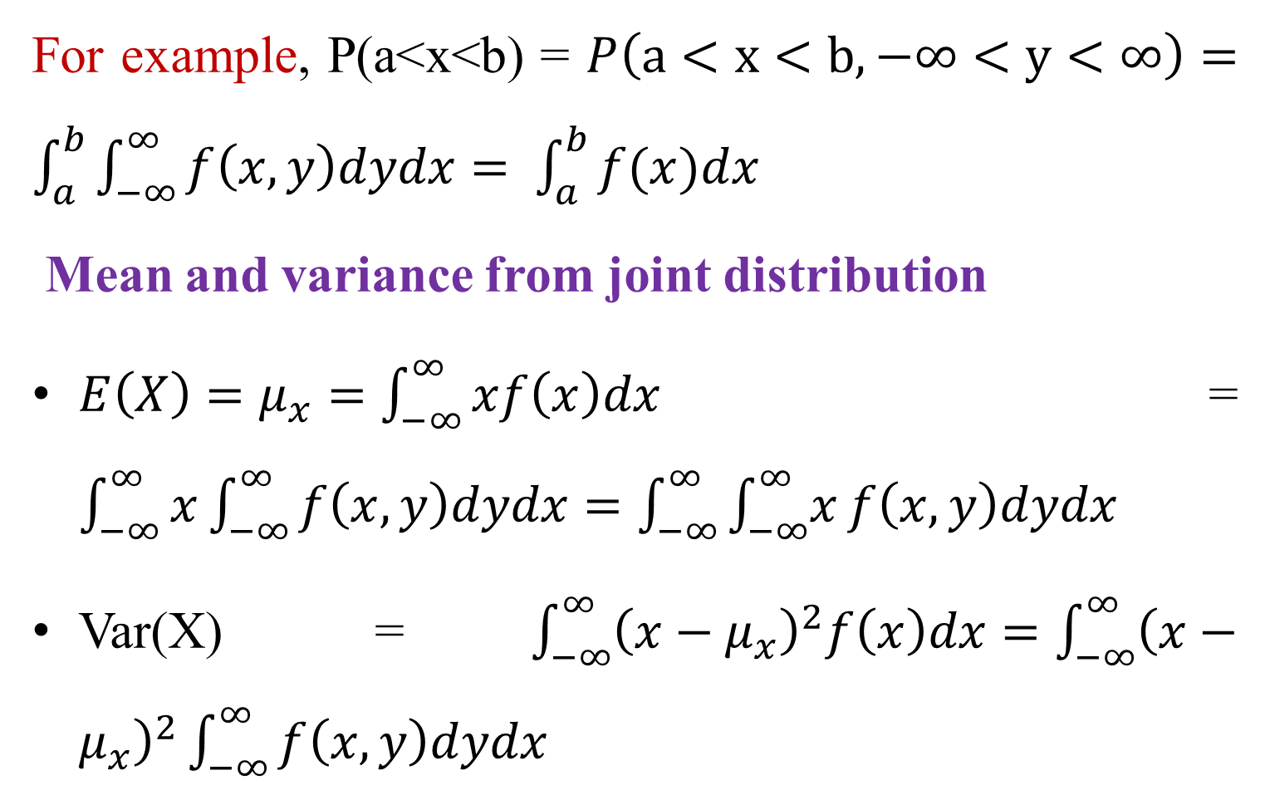
Con’t…
For example, P(a<x<b) = $P\left(a<x<b, −∞<y<∞\right)=\int_{a}^{b}{\int_{−∞}^{∞}{f\left(x,y\right)dydx= \int_{a}^{b}{f(x)dx}}}$
Mean and variance from joint distribution
$E\left(X\right)=μ_{x}=\int_{−∞}^{∞}{xf\left(x\right)dx}$ = $\int_{−∞}^{∞}{x\int_{−∞}^{∞}{f\left(x,y\right)dydx}}=\int_{−∞}^{∞}{\int_{−∞}^{∞}{x}f\left(x,y\right)dydx}$
Var(X) =$\int_{−∞}^{∞}{{\left(x−μ_{x}\right)}^{2}f\left(x\right)dx}=\int_{−∞}^{∞}{{\left(x−μ_{x}\right)}^{2}\int_{−∞}^{∞}{f\left(x,y\right)dydx}}$

Slide 19
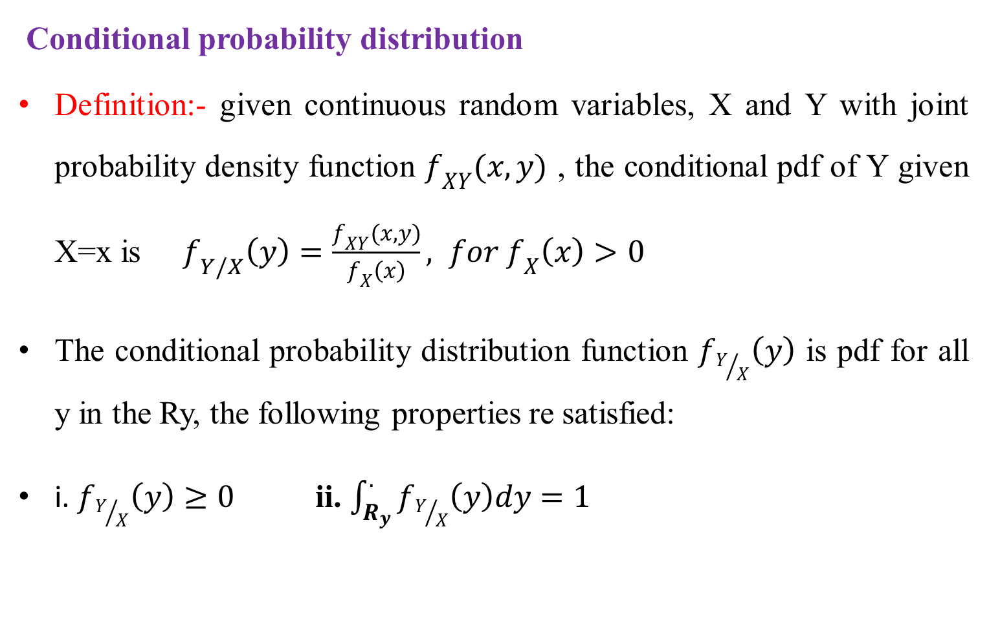
Con’t…
Conditional probability distribution
Definition:- given continuous random variables, X and Y with joint probability density function $f_{XY}(x,y)$ , the conditional pdf of Y given X=x is $f_{Y/X}\left(y\right)=\frac{f_{XY}(x,y)}{f_{X}\left(x\right)}, for f_{X}\left(x\right)>0$
The conditional probability distribution function $f_{Y/X}\left(y\right)$ is pdf for all y in the Ry, the following properties re satisfied:
i. $f_{Y/X}\left(y\right)≥0$ ii. $\int_{R_{y}}^{.}{f_{Y/X}\left(y\right)dy=1}$

Slide 20
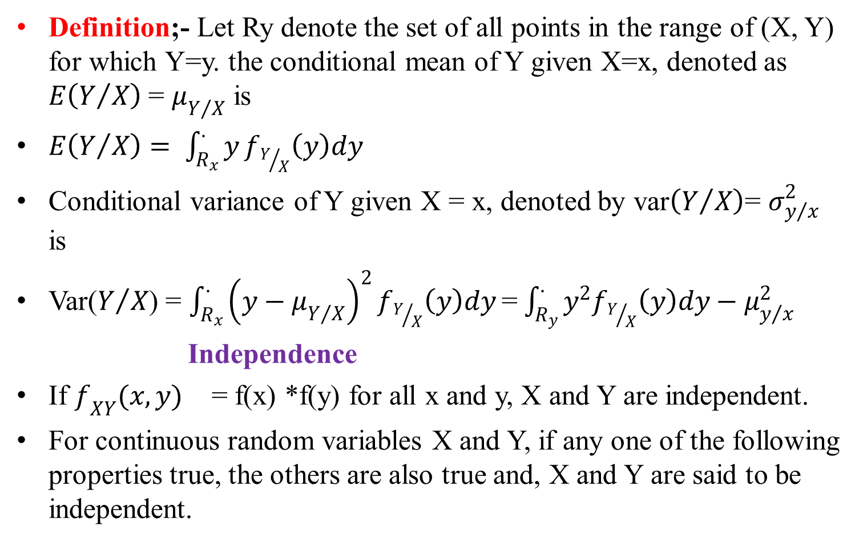
Con’t…
Definition;- Let Ry denote the set of all points in the range of (X, Y) for which Y=y. the conditional mean of Y given X=x, denoted as $E\left(Y/X\right)$ = $μ_{Y/X}$ is
$E\left(Y/X\right)= \int_{R_{x}}^{.}{y}f_{Y/X}\left(y\right)dy$
Conditional variance of Y given X = x, denoted by var$\left(Y/X\right)$= $σ_{y/x}^{2}$ is
Var($Y/X$) = $\int_{R_{x}}^{.}{{\left(y−μ_{Y/X}\right)}^{2}}f_{Y/X}\left(y\right)dy$=$\int_{R_{y}}^{.}{y^{2}f_{Y/X}\left(y\right)dy−μ_{y/x}^{2}}$
Independence
If $f_{XY}(x,y)$ = f(x) *f(y) for all x and y, X and Y are independent.
For continuous random variables X and Y, if any one of the following properties true, the others are also true and, X and Y are said to be independent.

Slide 21
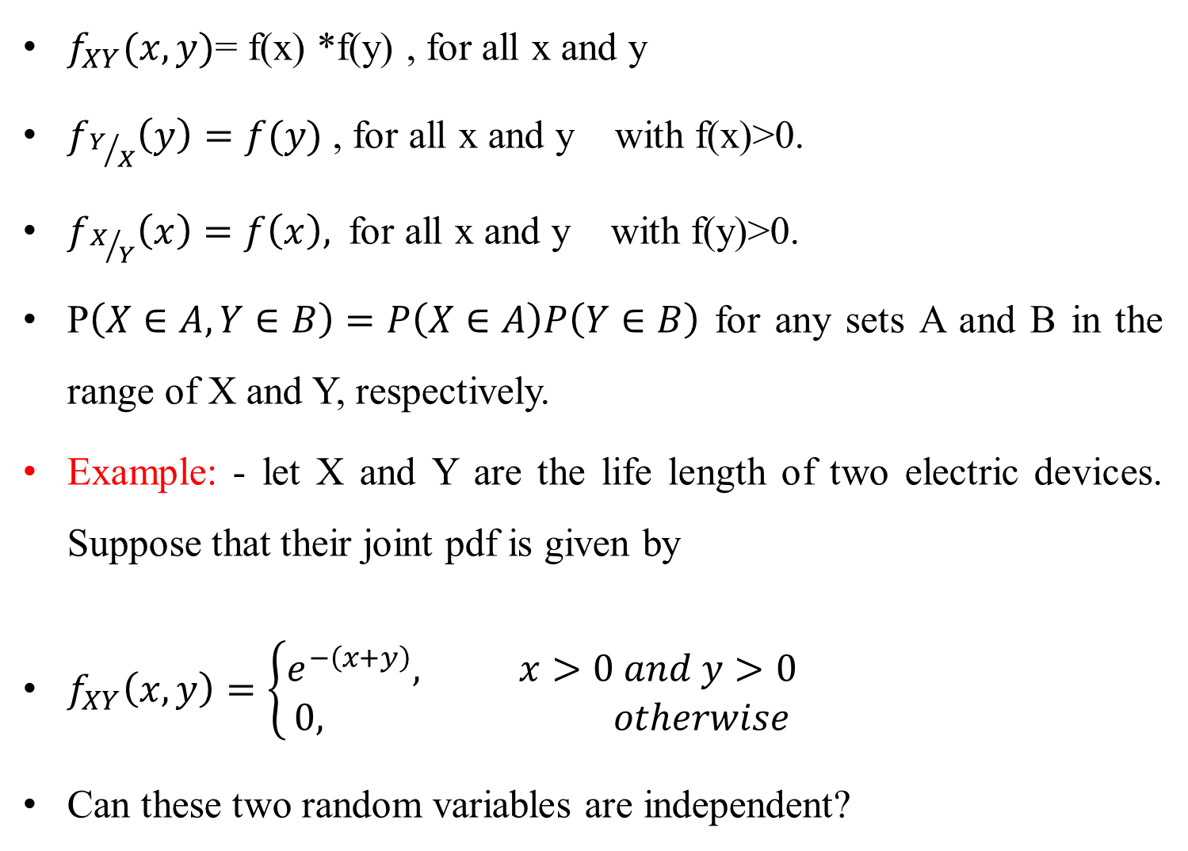
Con’t…
$f_{XY}(x,y)$= f(x) *f(y) , for all x and y
$f_{Y/X}\left(y\right)=f(y)$ , for all x and y with f(x)>0.
$f_{X/Y}\left(x\right)=f\left(x\right),$ for all x and y with f(y)>0.
P$\left(X∈A, Y∈B\right)=P\left(X∈A\right)P\left(Y∈B\right)$ for any sets A and B in the range of X and Y, respectively.
Example: - let X and Y are the life length of two electric devices. Suppose that their joint pdf is given by
$f_{XY}\left(x,y\right)=\left\{\begin{aligned}e^{−\left(x+y\right)}, x>0 and y>0 \\ 0, otherwise\end{aligned}\right.$
Can these two random variables are independent?

Slide 22
Multinomial and Trinomial Distribution
The multinomial distribution generalizes the binomial case to k outcomes.
It is probability distribution of experiments (multinomial trials) that have more two possible outcomes.
The trinomial distribution is a special case with exactly 3 outcomes.
A multinomial trials process is a sequence of independent, identically distributed random variables X=(X₁,X₂,…) each taking k possible values. Multinomial trials possess the following properties;
It consists of n trials.
For each trails there are k possible ME and exhaustive outcomes.
Trails are independent to each other’s
Trials are identical

Slide 23
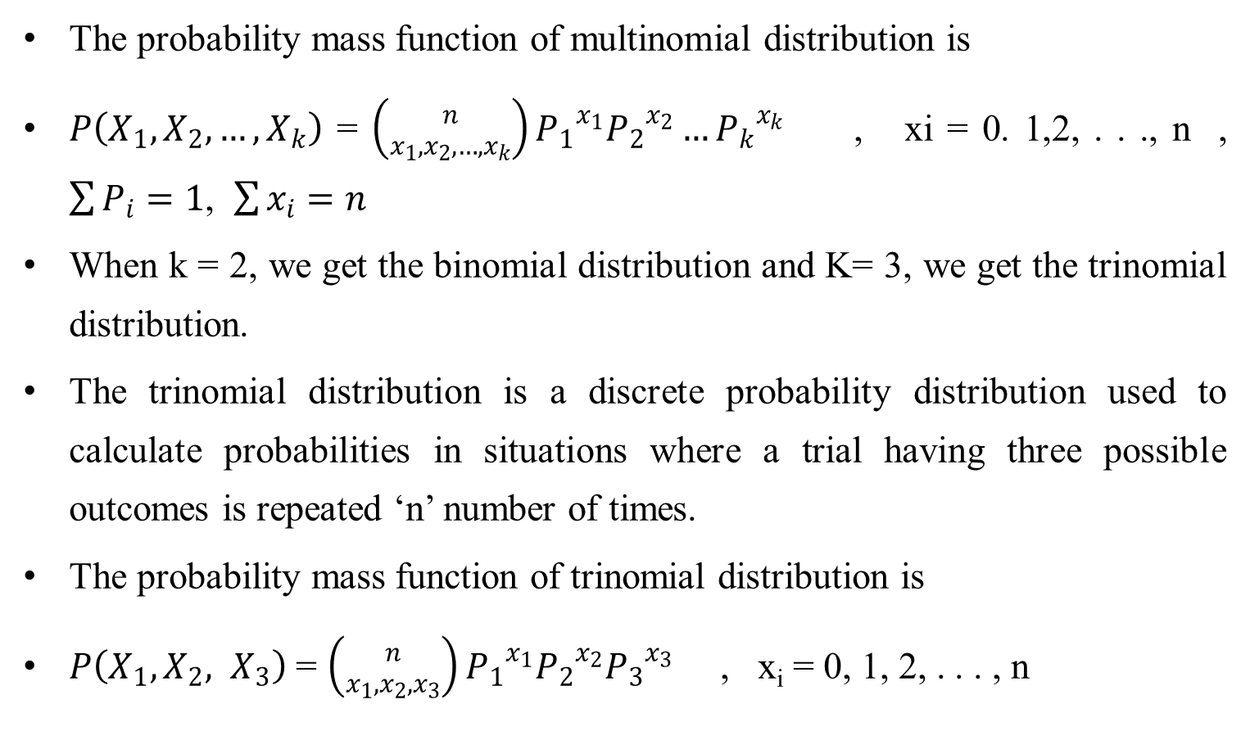
Con’t…
The probability mass function of multinomial distribution is
$P\left(X_{1},X_{2}, …, X_{k}\right)$ = $\left({n \atop x_{1}, x_{2}, …,x_{k}}\right){P_{1}}^{x_{1}}{P_{2}}^{x_{2}}…{P_{k}}^{x_{k}}$ , xi = 0. 1,2, . . ., n , $\sum{P_{i}}=1$, $\sum{x_{i}=n}$
When k = 2, we get the binomial distribution and K= 3, we get the trinomial distribution.
The trinomial distribution is a discrete probability distribution used to calculate probabilities in situations where a trial having three possible outcomes is repeated ‘n’ number of times.
The probability mass function of trinomial distribution is
$P\left(X_{1},X_{2}, X_{3}\right)$ = $\left({n \atop x_{1}, x_{2},x_{3}}\right){P_{1}}^{x_{1}}{P_{2}}^{x_{2}}{P_{3}}^{x_{3}}$ , x_{i} = 0, 1, 2, . . . , n

Slide 24
Con’t…
Example : Suppose a game between 3 players A, B and C is repeated 12 times. Player A has a 50% chance of winning a game, player B has a 30% chance of winning the game and player C has a 20% winning probability. Calculate the probability that player A wins 4 games, player B wins 3 games and player C wins the remaining 5 games.

Slide 25
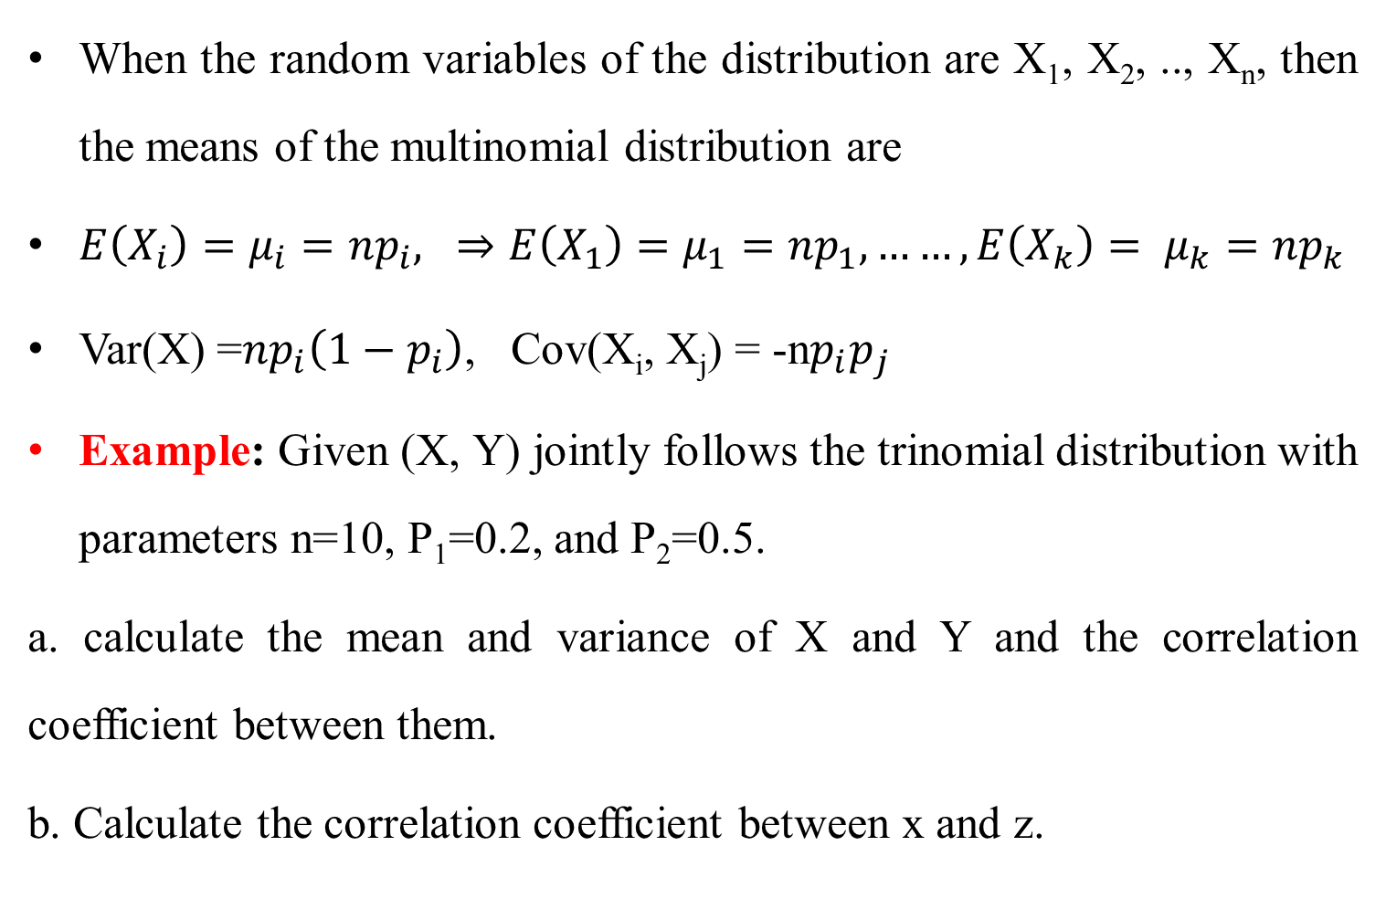
The expected value of multinomial Distribution
When the random variables of the distribution are X₁, X₂, .., X_{n}, then the means of the multinomial distribution are
$E\left(X_{i}\right)=μ_{i}=np_{i}, ⇒E\left(X_{1}\right)=μ_{1}=np_{1}, ……, E\left(X_{k}\right)= μ_{k}=np_{k}$
Var(X) =$np_{i}\left(1−p_{i}\right)$, Cov(X_{i}, X_{j}) = -n$p_{i}p_{j}$
Example: Given (X, Y) jointly follows the trinomial distribution with parameters n=10, P₁=0.2, and P₂=0.5.
a. calculate the mean and variance of X and Y and the correlation coefficient between them.
b. Calculate the correlation coefficient between x and z.

Slide 26
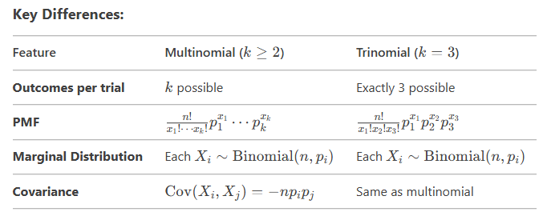
Con’t…

Slide 27
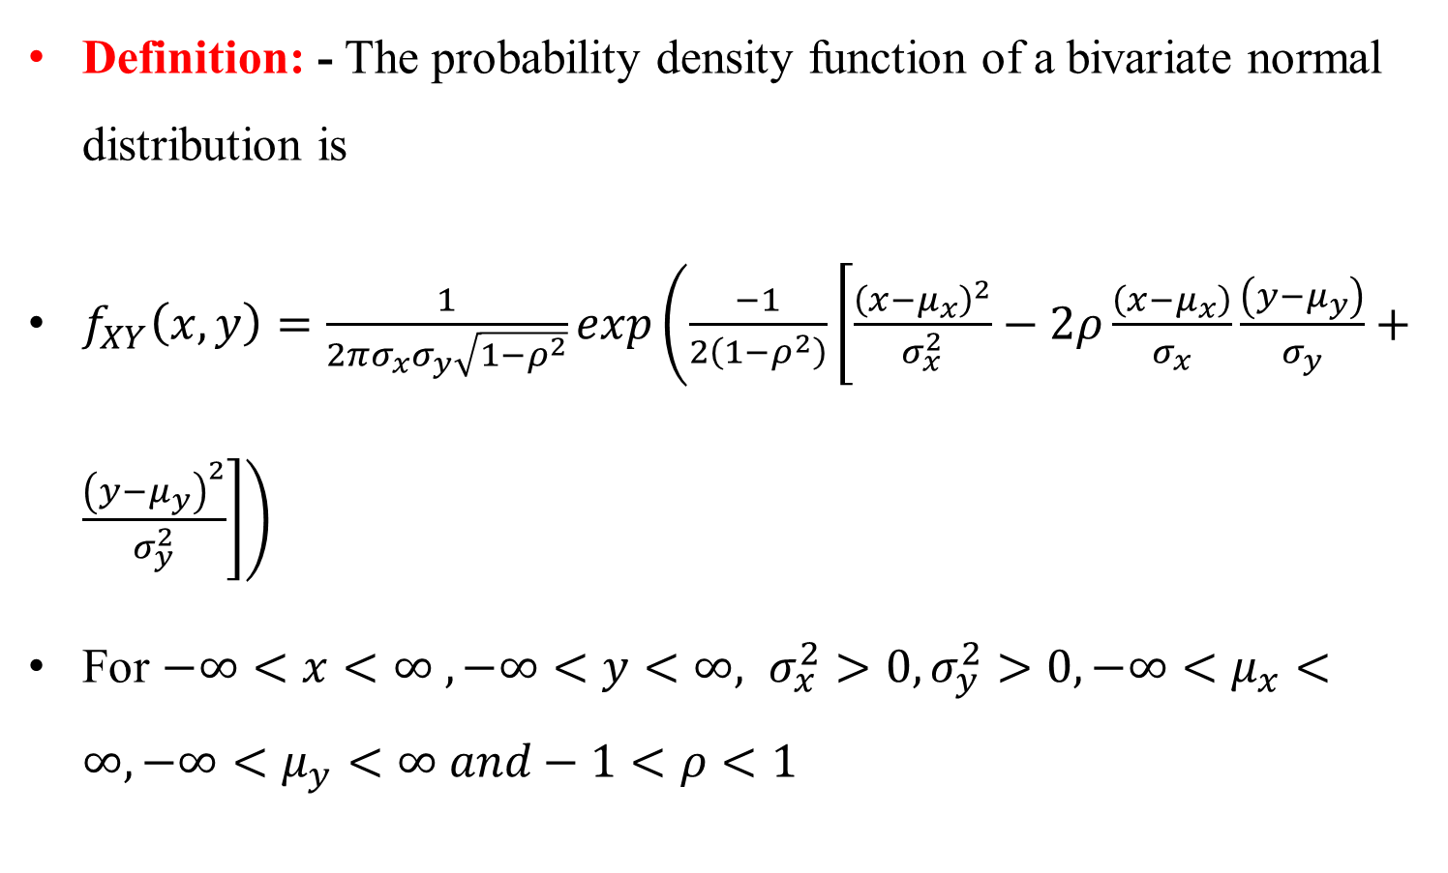
Bivariate normal distribution
Definition: - The probability density function of a bivariate normal distribution is
$f_{XY}\left(x,y\right)=\frac{1}{2πσ_{x}σ_{y}\sqrt{1−ρ^{2}}}exp\left(\frac{−1}{2\left(1−ρ^{2}\right)}\left[\frac{{\left(x−μ_{x}\right)}^{2}}{σ_{x}^{2}}−2ρ\frac{\left(x−μ_{x}\right)}{σ_{x}}\frac{\left(y−μ_{y}\right)}{σ_{y}}+\frac{{\left(y−μ_{y}\right)}^{2}}{σ_{y}^{2}}\right]\right)$
For $−∞<x<∞ , −∞<y<∞, σ_{x}^{2}>0,σ_{y}^{2}>0,−∞<μ_{x}<∞, −∞<μ_{y}<∞ and−1<ρ<1$

Slide 28
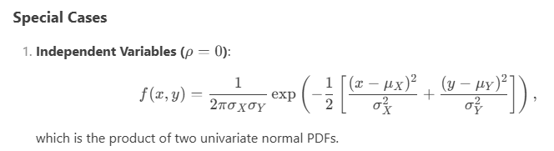

Con’t…
$$f_{XY}\left(x,y\right)=$$

Slide 29
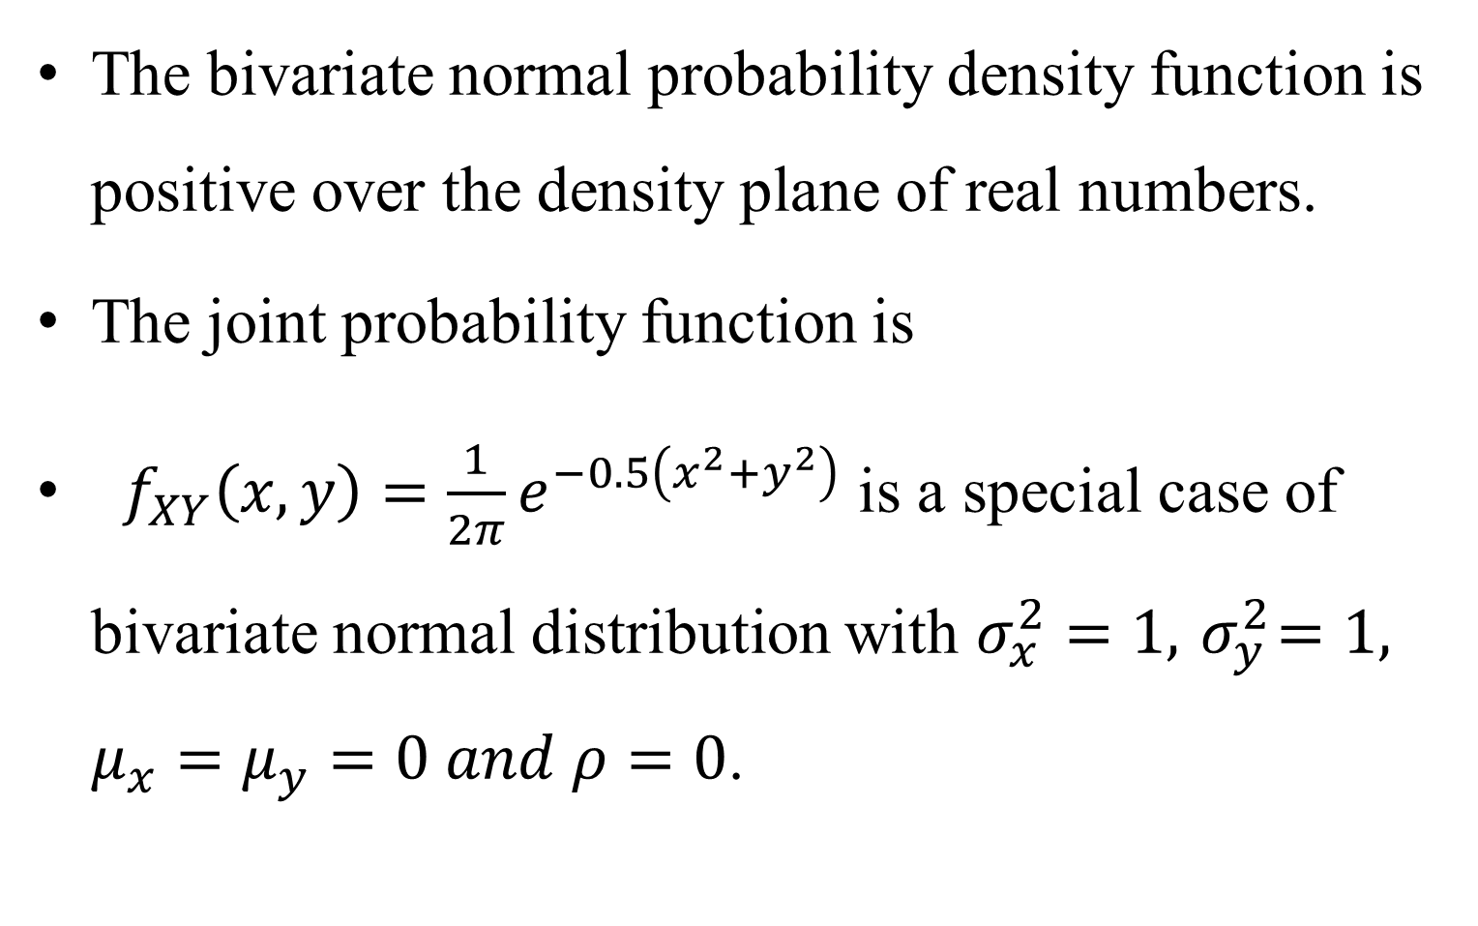
Con’t…
The bivariate normal probability density function is positive over the density plane of real numbers.
The joint probability function is
$f_{XY}\left(x,y\right)=\frac{1}{2π}e^{−0.5\left(x^{2}+y^{2}\right)}$ is a special case of bivariate normal distribution with $σ_{x}^{2}=1,{ σ}_{y}^{2}=1, μ_{x}=μ_{y}=0 and ρ=0$.

Slide 30
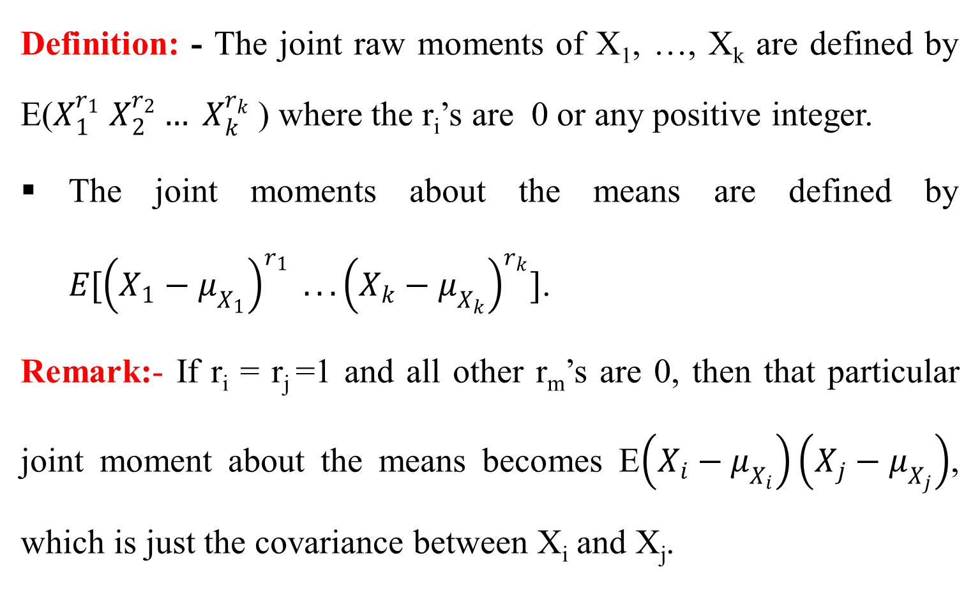
3.4 Joint moment generating functions and moments
Definition: - The joint raw moments of X₁, …, X_{k} are defined by E($X_{1}^{r_{1}} X_{2}^{r_{2}}… X_{k}^{r_{k}}$) where the r_{i}’s are 0 or any positive integer.
The joint moments about the means are defined by $E[{\left(X_{1}−μ_{X_{1}}\right)}^{r_{1}} . . .{\left(X_{k}−μ_{X_{k}}\right)}^{r_{k}}]$.
Remark:- If r_{i} = r_{j} =1 and all other r_{m}’s are 0, then that particular joint moment about the means becomes E$\left(X_{i}−μ_{X_{i}}\right)\left(X_{j}−μ_{X_{j}}\right)$, which is just the covariance between X_{i} and X_{j}.

Slide 31
Con’t…
Covariance measures how much two random variables change together.
If Xi and Xj tend to increase together, the covariance is positive.
If one tends to increase when the other decreases, the covariance is negative.
If Xi and Xj​ are independent, their covariance is 0.

Slide 32
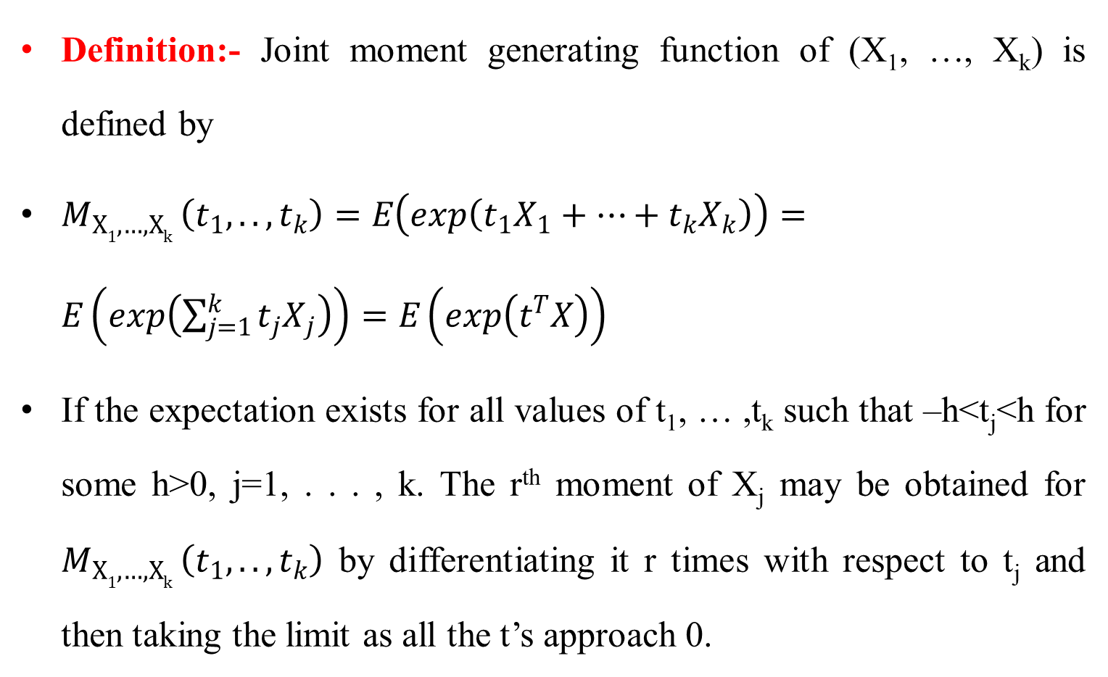
Con’t…
Definition:- Joint moment generating function of (X₁, …, X_{k}) is defined by
$M_{X1, …, Xk }\left(t_{1}, . . , t_{k}\right)=E\left(exp\left(t_{1}X_{1}+…+t_{k}X_{k}\right)\right)=E\left(exp\left(\sum_{j=1}^{k}{t_{j}X_{j}}\right)\right)=E\left(exp\left(t^{T}X\right)\right)$
If the expectation exists for all values of t₁, … ,t_{k} such that –h<t_{j}<h for some h>0, j=1, . . . , k. The r^{th} moment of X_{j} may be obtained for $M_{X1, …, Xk }\left(t_{1}, . . , t_{k}\right)$ by differentiating it r times with respect to t_{j} and then taking the limit as all the t’s approach 0.

Slide 33
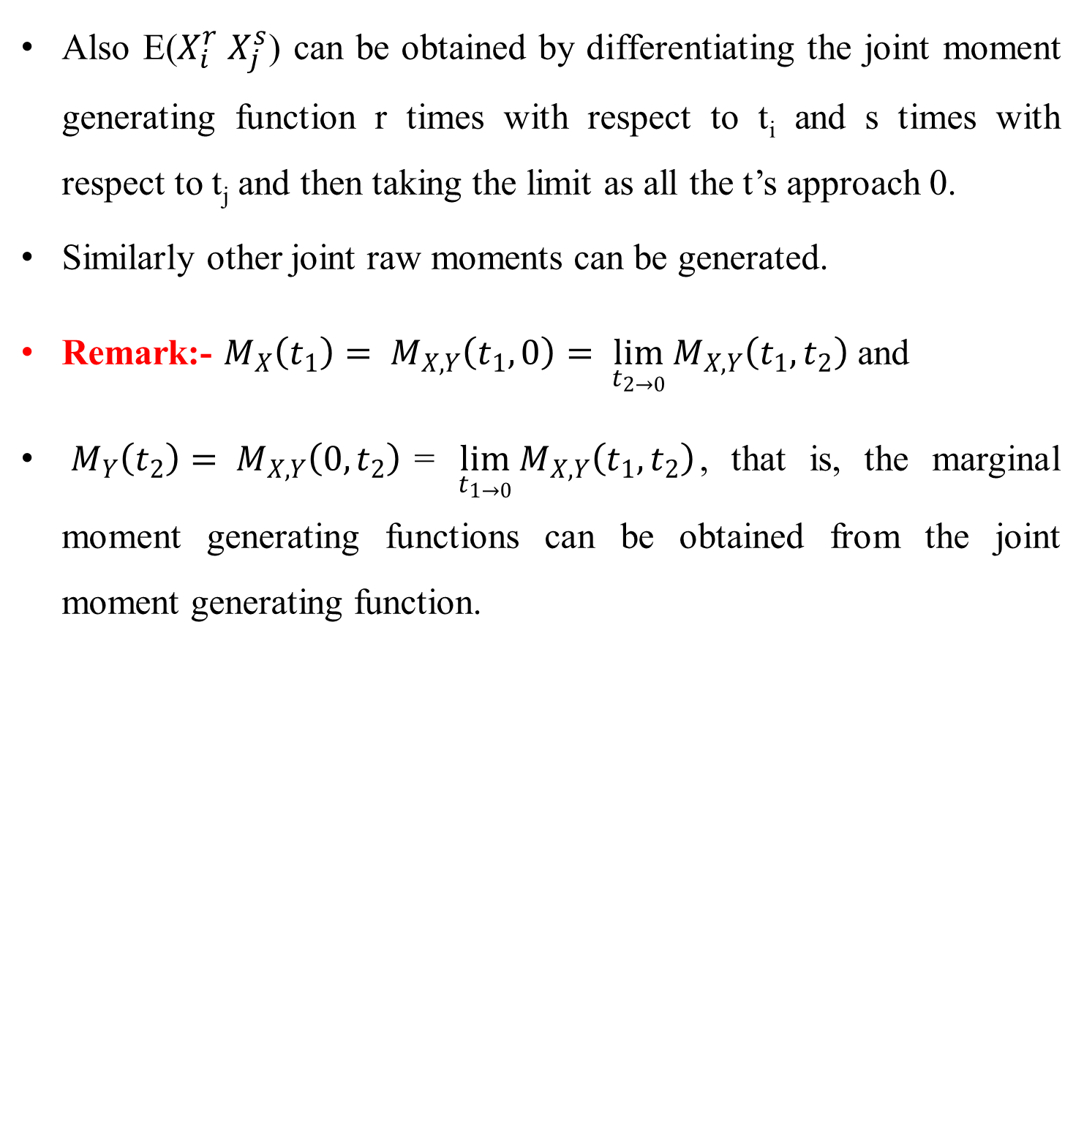
Con’t…
Also E($X_{i}^{r} X_{j}^{s}$) can be obtained by differentiating the joint moment generating function r times with respect to t_{i} and s times with respect to t_{j} and then taking the limit as all the t’s approach 0.
Similarly other joint raw moments can be generated.
Remark:- $M_{X}\left(t_{1}\right)= M_{X,Y}\left(t_{1},0\right)= \lim_{t_{2→0}}{M_{X,Y}\left(t_{1}, t_{2}\right)}$ and
$M_{Y}\left(t_{2}\right)= M_{X,Y}\left(0,t_{2}\right)$= $\lim_{t_{1→0}}{M_{X,Y}\left(t_{1}, t_{2}\right)}$, that is, the marginal moment generating functions can be obtained from the joint moment generating function.

Slide 34
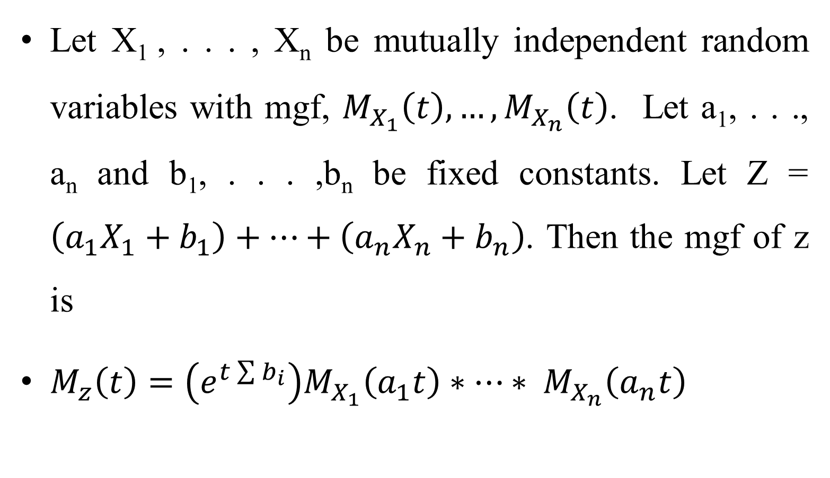
Con’t…
Let X₁ , . . . , X_{n} be mutually independent random variables with mgf, $M_{X_{1}}\left(t\right), …, M_{X_{n}}\left(t\right)$. Let a₁, . . ., a_{n} and b₁, . . . ,b_{n} be fixed constants. Let Z = $\left(a_{1}X_{1}+b_{1}\right)+…+\left(a_{n}X_{n}+b_{n}\right)$. Then the mgf of z is
$M_{z}\left(t\right)=\left(e^{t\sum{b_{i}}}\right)M_{X_{1}}\left(a_{1}t\right)∗…∗ M_{X_{n}}\left(a_{n}t\right)$

Slide 35
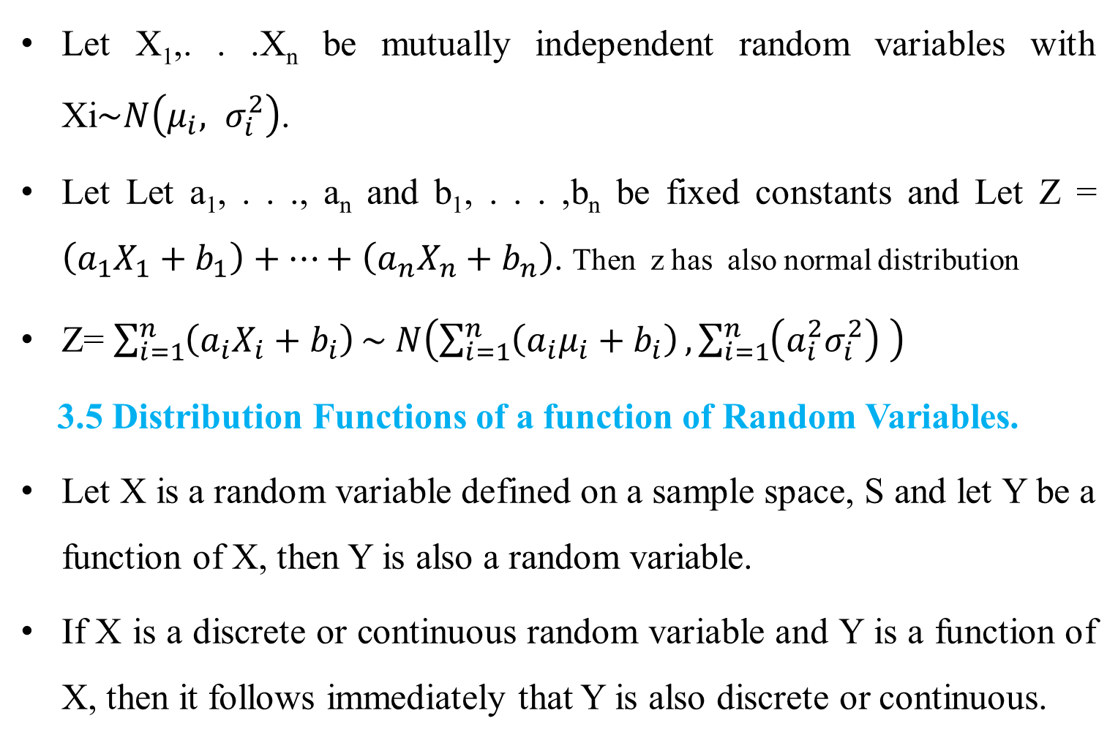
Con’t…
Let X₁,. . .X_{n} be mutually independent random variables with Xi$\sim N\left(μ_{i}, σ_{i}^{2}\right)$.
Let Let a₁, . . ., a_{n} and b₁, . . . ,b_{n} be fixed constants and Let Z = $\left(a_{1}X_{1}+b_{1}\right)+…+\left(a_{n}X_{n}+b_{n}\right)$. Then z has also normal distribution
Z= $\sum_{i=1}^{n}{\left(a_{i}X_{i}+b_{i}\right)}\sim N\left(\sum_{i=1}^{n}{\left(a_{i}μ_{i}+b_{i}\right)}, \sum_{i=1}^{n}{\left(a_{i}^{2}σ_{i}^{2}\right)} \right)$
3.5 Distribution Functions of a function of Random Variables.
Let X is a random variable defined on a sample space, S and let Y be a function of X, then Y is also a random variable.
If X is a discrete or continuous random variable and Y is a function of X, then it follows immediately that Y is also discrete or continuous.

Slide 36
Con’t…
There are three different methods that used to find probability distribution of a function of Random Variables
- Cumulative distribution function technique
- Moment generating function technique
- Transformation technique
Cumulative Distribution Function Technique
This is the most general method and works for any type of random variable (discrete, continuous, or mixed).
A straight forward method of obtaining the probability density function of continuous random variable consists of 1st finding its distribution function and then pdf by differentiation.

Slide 37
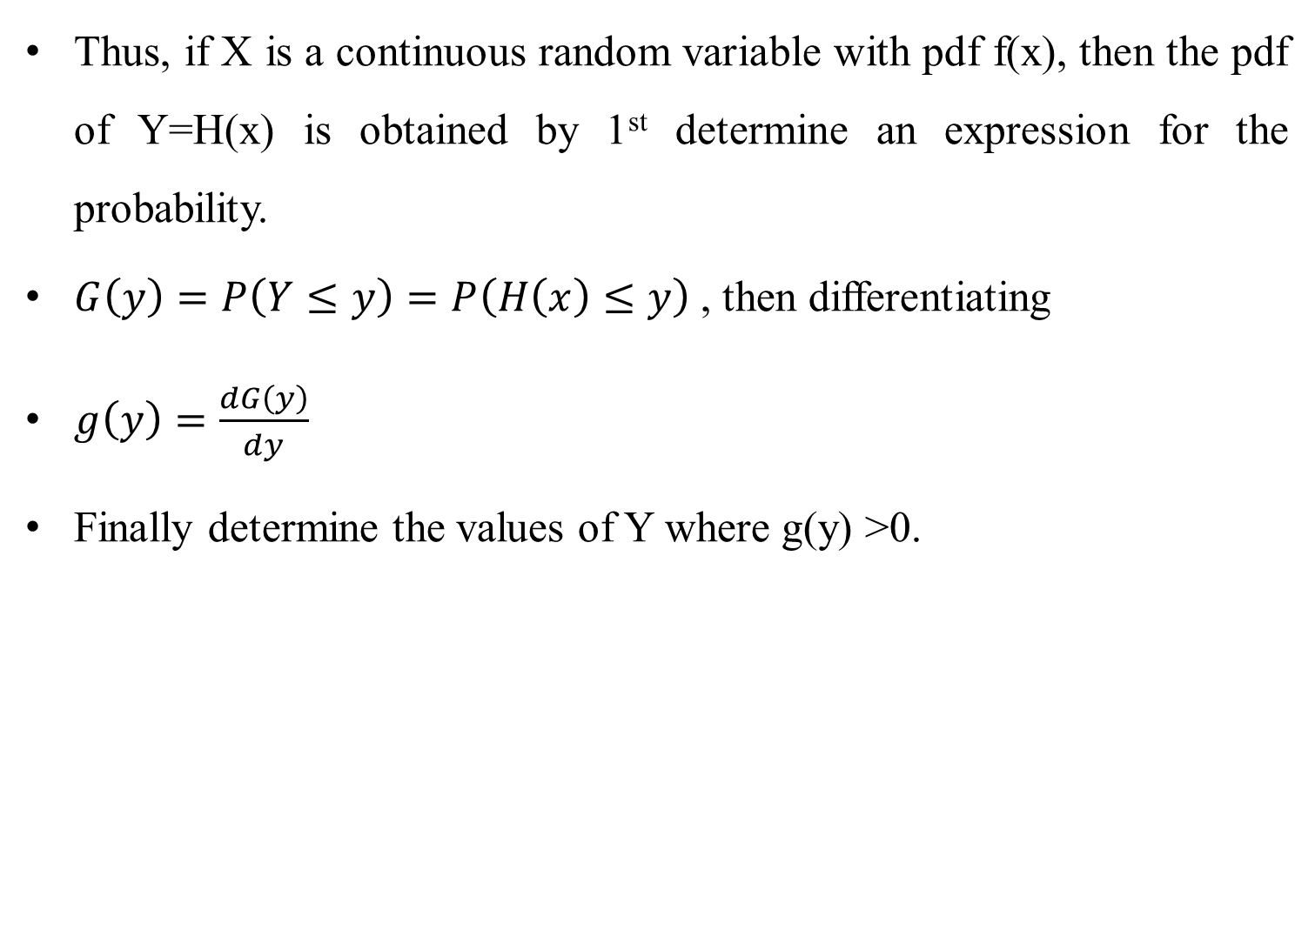
Con’t…
Thus, if X is a continuous random variable with pdf f(x), then the pdf of Y=H(x) is obtained by 1st determine an expression for the probability.
$G\left(y\right)=P\left(Y≤y\right)=P\left(H\left(x\right)≤y\right)$ , then differentiating
$g\left(y\right)=\frac{dG\left(y\right)}{dy}$
Finally determine the values of Y where g(y) >0.

Slide 38
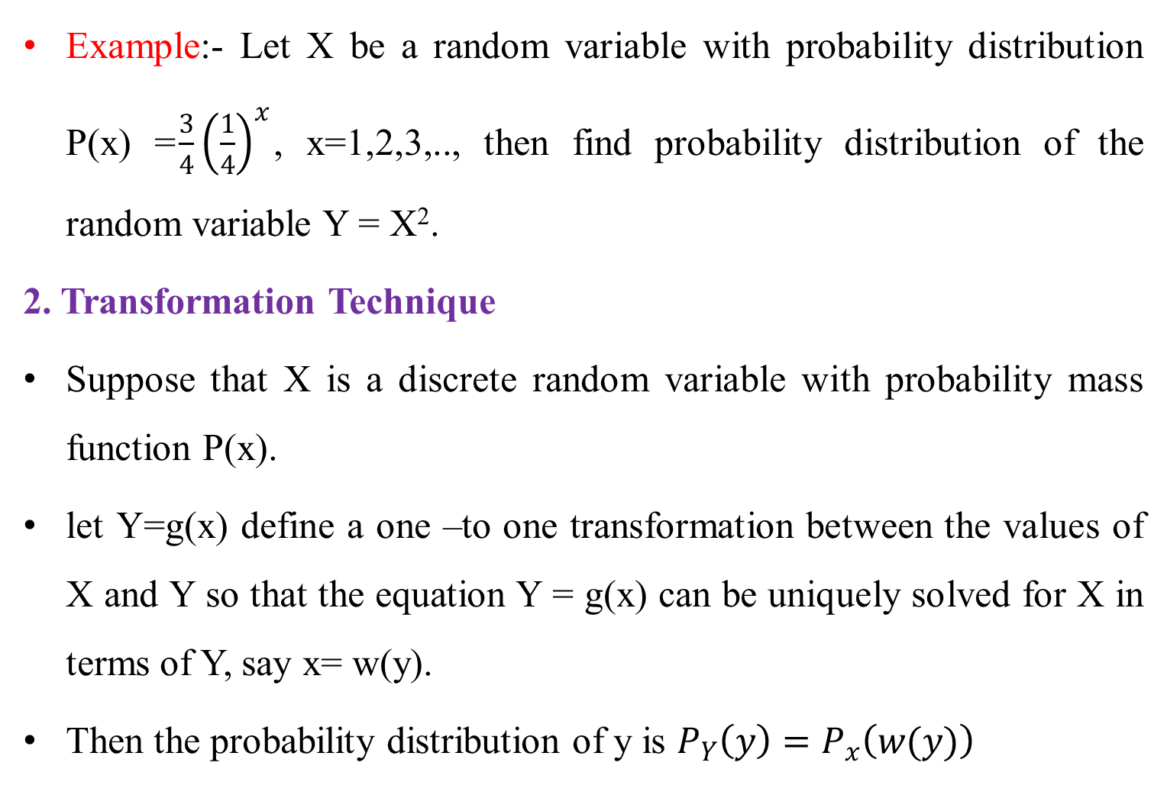
Con’t…
Example:- Let X be a random variable with probability distribution P(x) =$\frac{3}{4}{\left(\frac{1}{4}\right)}^{x}$, x=1,2,3,.., then find probability distribution of the random variable Y = X².
2. Transformation Technique
Suppose that X is a discrete random variable with probability mass function P(x).
let Y=g(x) define a one –to one transformation between the values of X and Y so that the equation Y = g(x) can be uniquely solved for X in terms of Y, say x= w(y).
Then the probability distribution of y is $P_{Y}\left(y\right)=P_{x}\left(w(y)\right)$

Slide 39
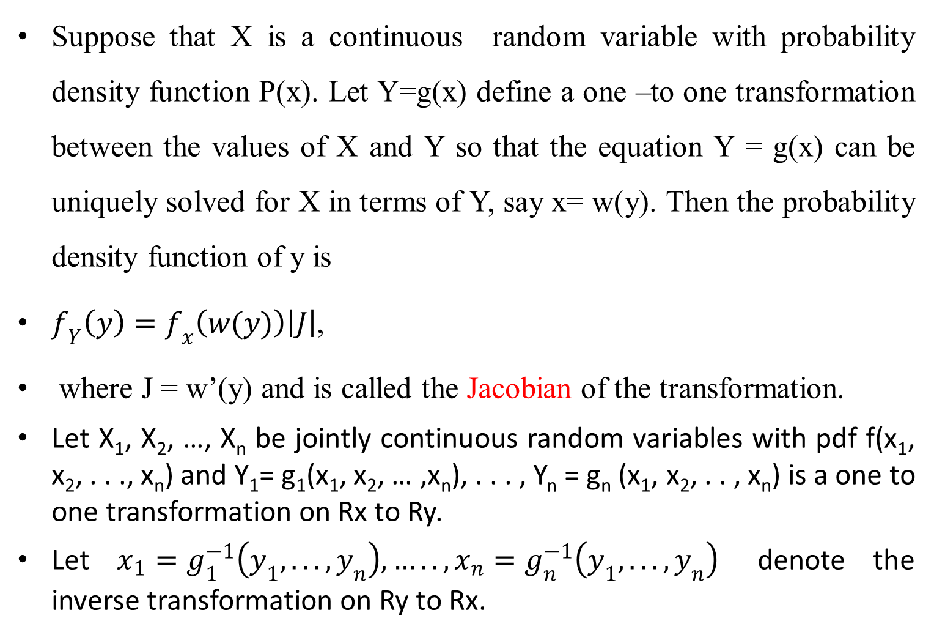
Con’t…
Suppose that X is a continuous random variable with probability density function P(x). Let Y=g(x) define a one –to one transformation between the values of X and Y so that the equation Y = g(x) can be uniquely solved for X in terms of Y, say x= w(y). Then the probability density function of y is
$f_{Y}\left(y\right)=f_{x}\left(w(y)\right)\left|J\right|$,
where J = w’(y) and is called the Jacobian of the transformation.
Let X₁, X₂, …, X_{n} be jointly continuous random variables with pdf f(x₁, x₂, . . ., x_{n}) and Y₁= g₁(x₁, x₂, … ,x_{n}), . . . , Y_{n} = g_{n} (x₁, x₂, . . , x_{n}) is a one to one transformation on Rx to Ry.
Let $x_{1}=g_{1}^{−1}\left(y_{1}, . . . , y_{n}\right), ….. , x_{n}=g_{n}^{−1}\left(y_{1}, . . . , y_{n}\right)$ denote the inverse transformation on Ry to Rx.

Slide 40
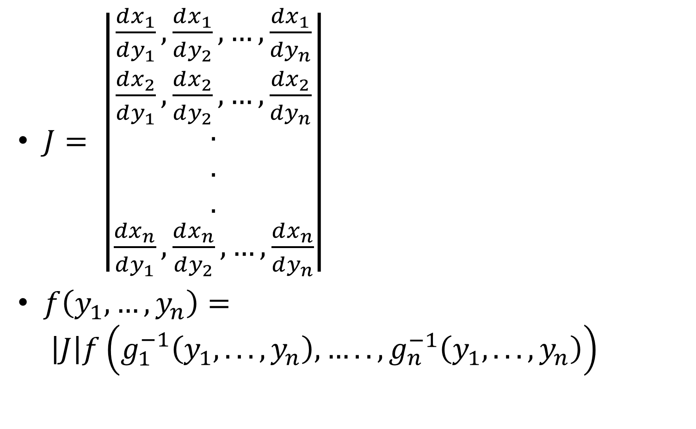
Con’t…
$J= \left|\begin{aligned}\frac{dx_{1}}{dy_{1}}, \frac{dx_{1}}{dy_{2}},…,\frac{dx_{1}}{dy_{n}} \\ \frac{dx_{2}}{dy_{1}}, \frac{dx_{2}}{dy_{2}},…,\frac{dx_{2}}{dy_{n}} \\ . \\ . \\ . \\ \frac{dx_{n}}{dy_{1}}, \frac{dx_{n}}{dy_{2}},…,\frac{dx_{n}}{dy_{n}}\end{aligned}\right|$
$f\left(y_{1},…,y_{n}\right)= \left|J\right|f\left(g_{1}^{−1}\left(y_{1}, . . . , y_{n}\right), ….. ,g_{n}^{−1}\left(y_{1}, . . . , y_{n}\right)\right)$

Slide 41
Con’t…
3. Moment Generating Function Technique
Let X₁, X₂, …, X_{n} be jointly continuous random variables with pdf f(x₁, x₂, . . ., x_{n}) and Y₁= g₁(x₁, x₂, … ,x_{n}), . . . , Y_{n} = g_{n} (x₁, x₂, . . , x_{n}) is a one to one transformation on Rx to Ry. It is possible to find jpdf of Y₁= g₁(x₁, x₂, … ,x_{n}), . . . , Y_{n} = g_{n} (x₁, x₂, . . , x_{n}) from the joint mgf.

Slide 42
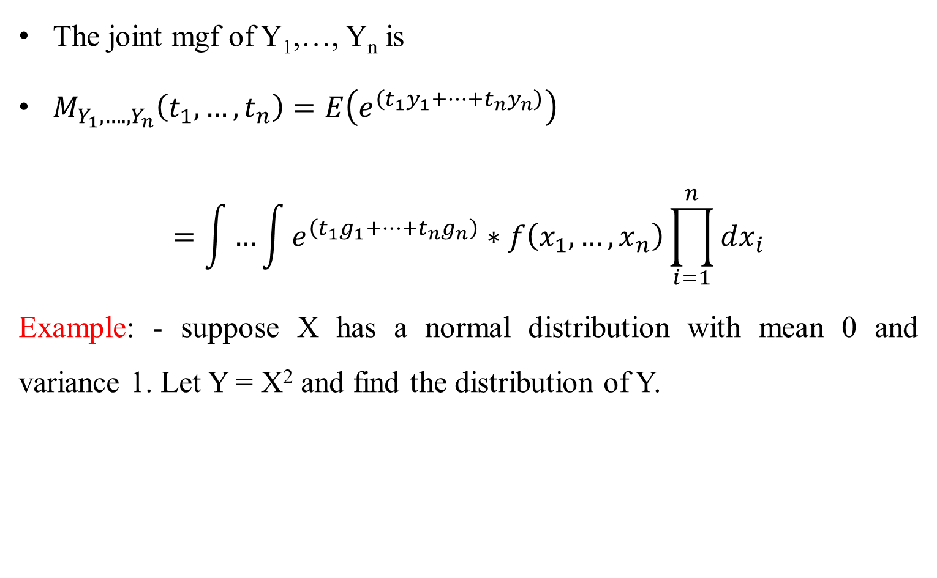
Con’t…
The joint mgf of Y₁,…, Y_{n} is
$M_{Y_{1},….,Y_{n}}\left(t_{1},…,t_{n}\right)=E\left(e^{\left(t_{1}y_{1}+…+t_{n}y_{n}\right)}\right)$
$$=\int{…\int{e^{\left(t_{1}g_{1}+…+t_{n}g_{n}\right)}}}∗f\left(x_{1},…,x_{n}\right)\prod_{i=1}^{n}{dx_{i}}$$
Example: - suppose X has a normal distribution with mean 0 and variance 1. Let Y = X² and find the distribution of Y.

